Slide 1
MacArthur Museum:
ARCHIVISE
Sarah Aldrich Rory Bell Amber Emeny

Slide 2
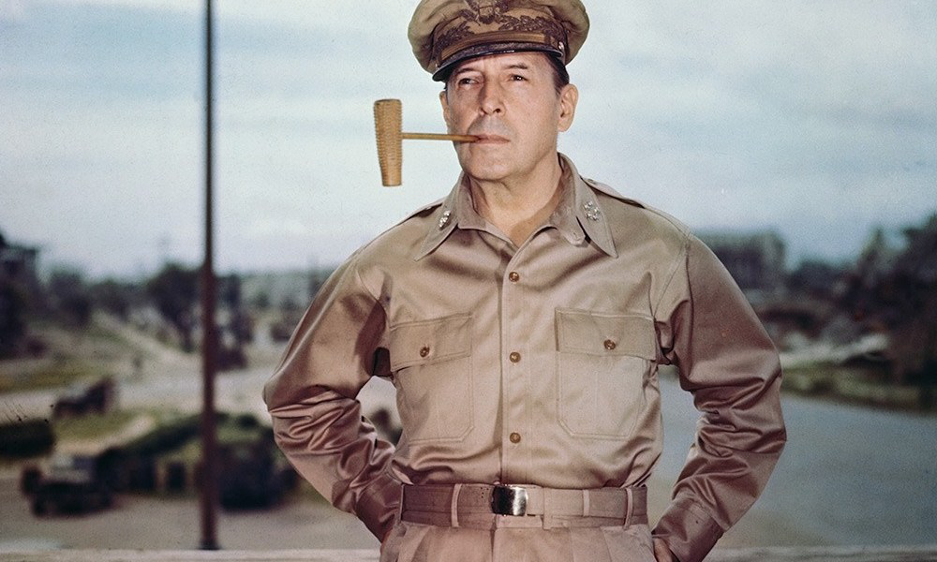
Purpose
Museum w/ small budget
Consulted with them in the past
How to store their digital photos?
If Janel can do it in a week, can we do it in three?

Slide 3

Project Planning
Yay A-Team!
Familiar tools give way to Jira & Confluence
Meeting with the Client
Detailed Wireframes

Slide 4
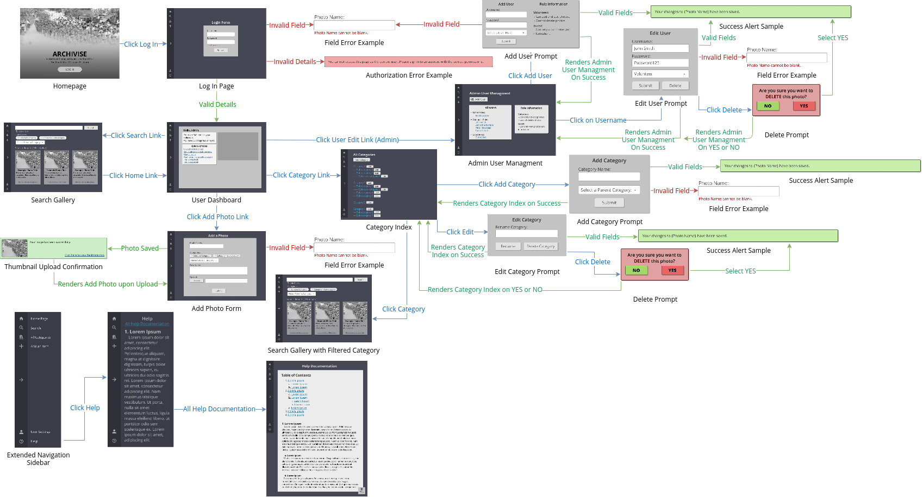
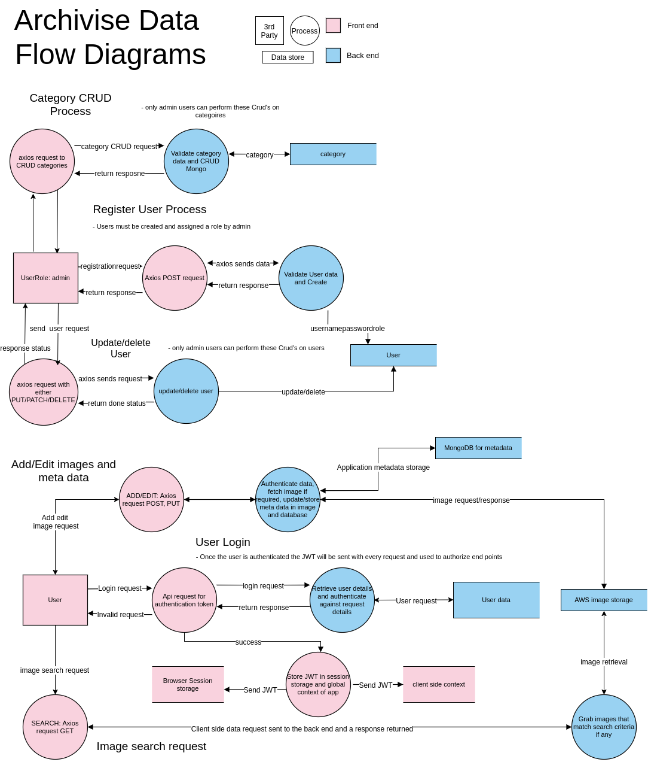
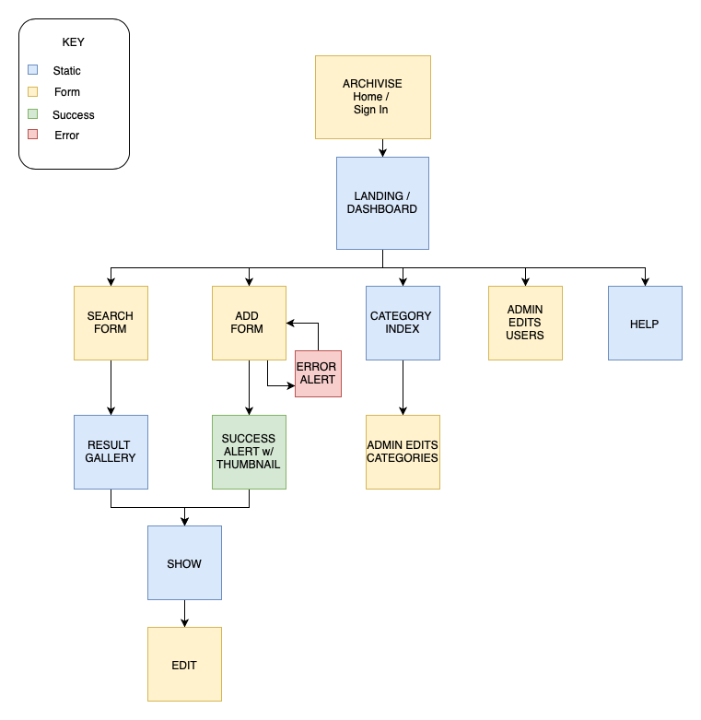
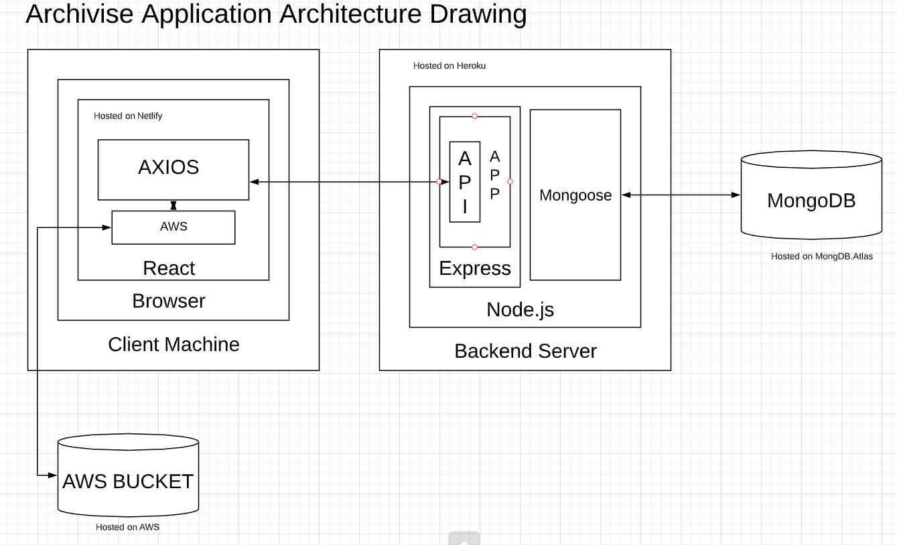
DFD / Architecture

Slide 5
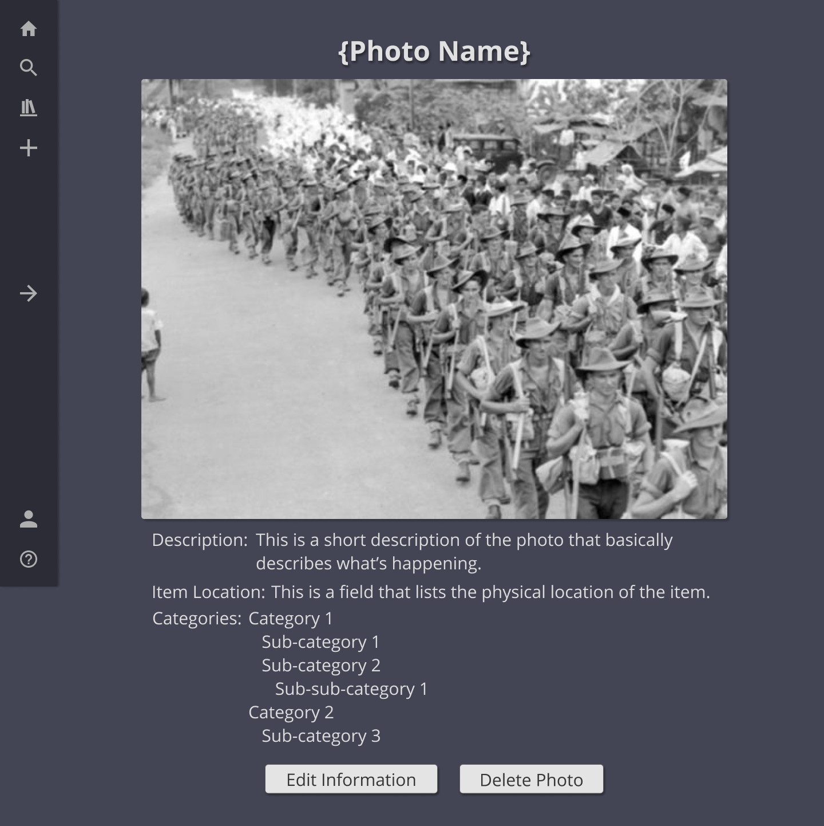
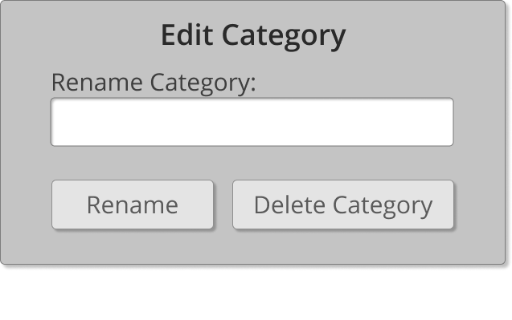
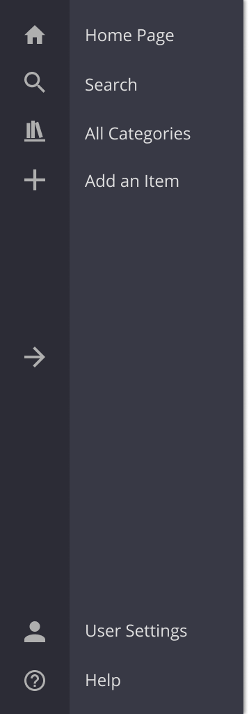
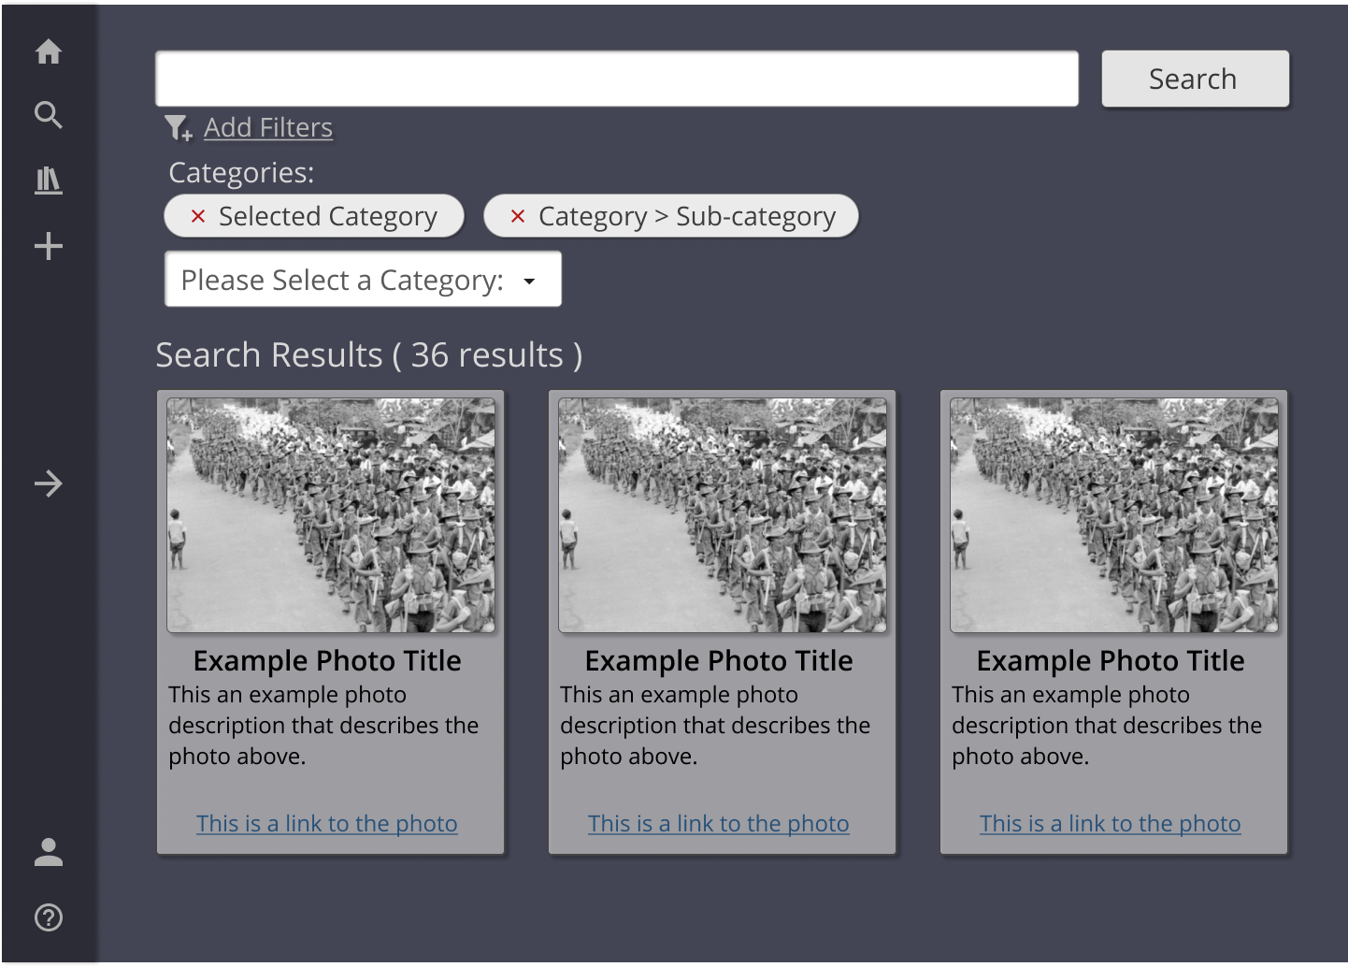
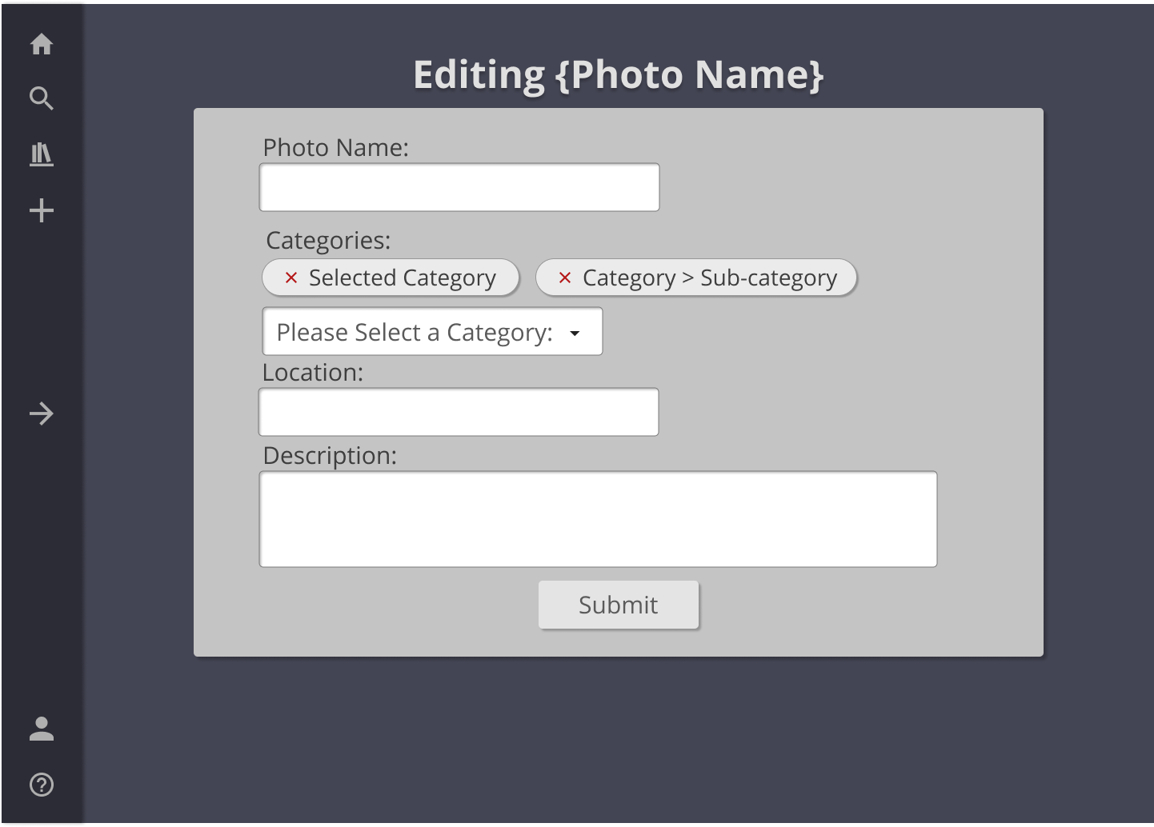
Wireframes

Slide 6
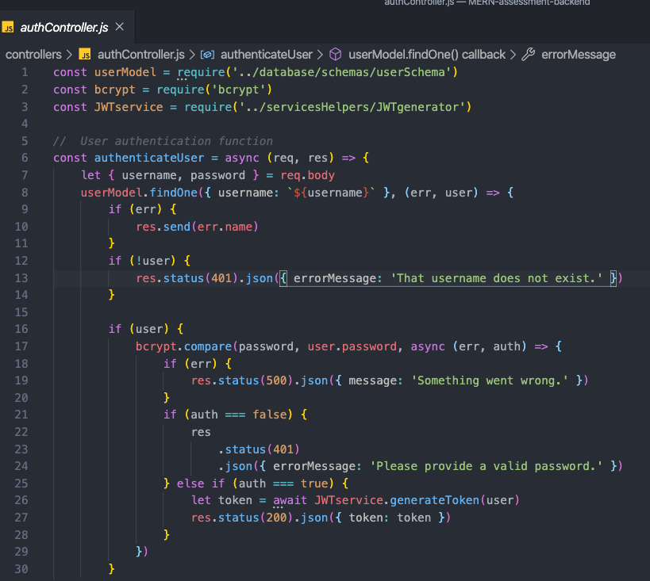
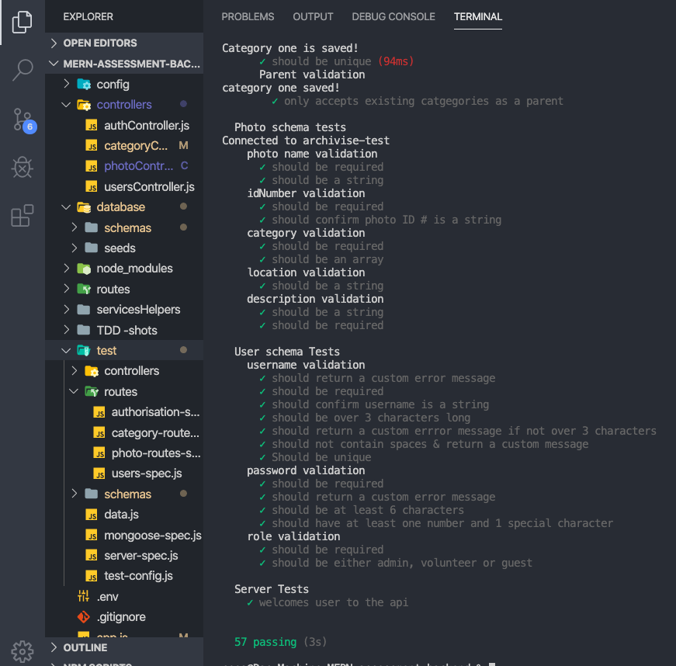
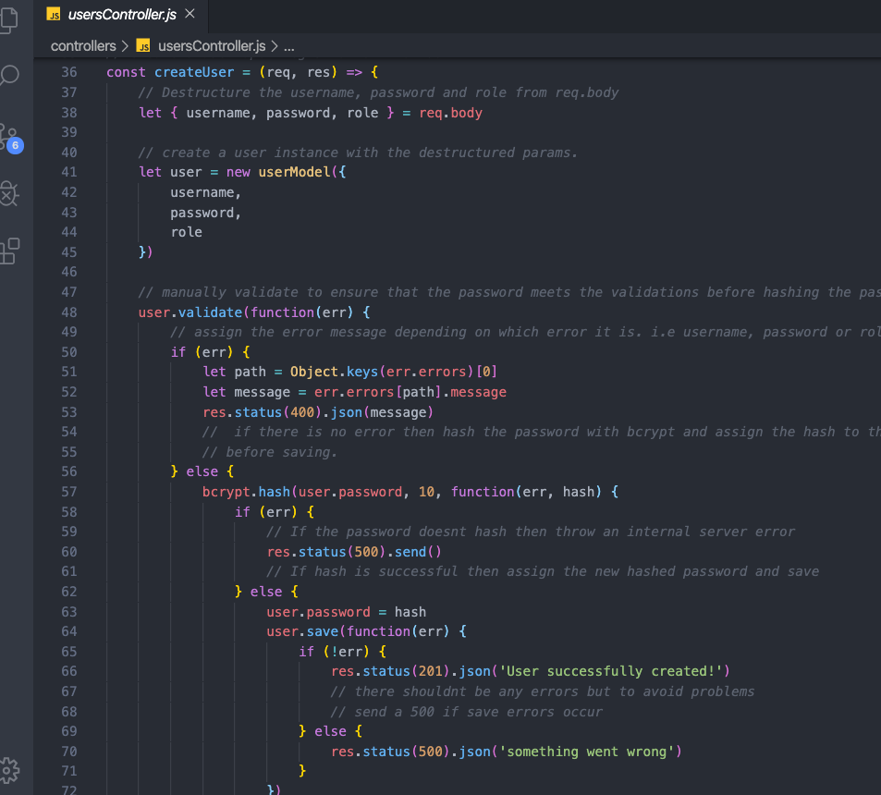
BACKEND CODE…

Slide 7
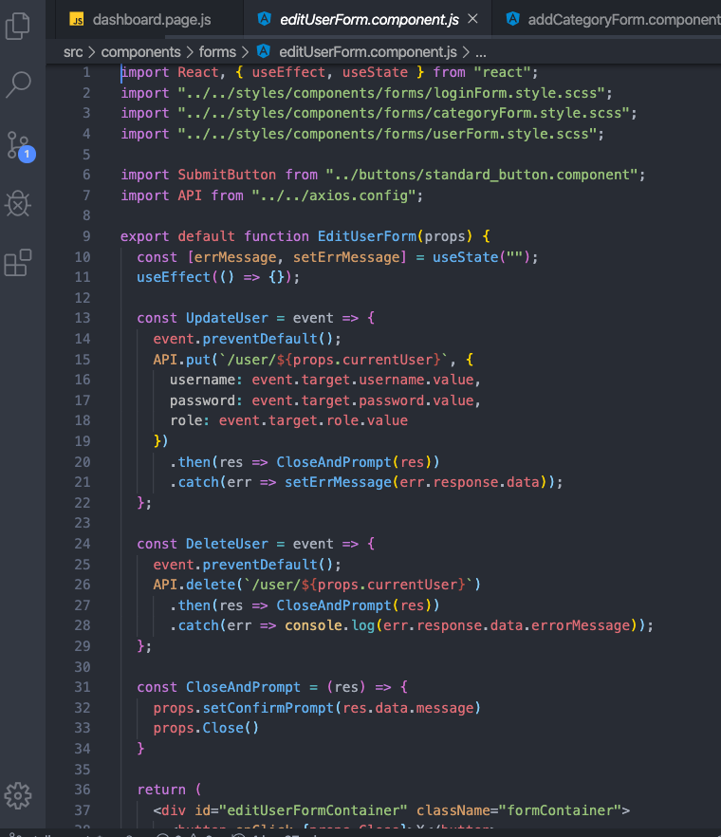
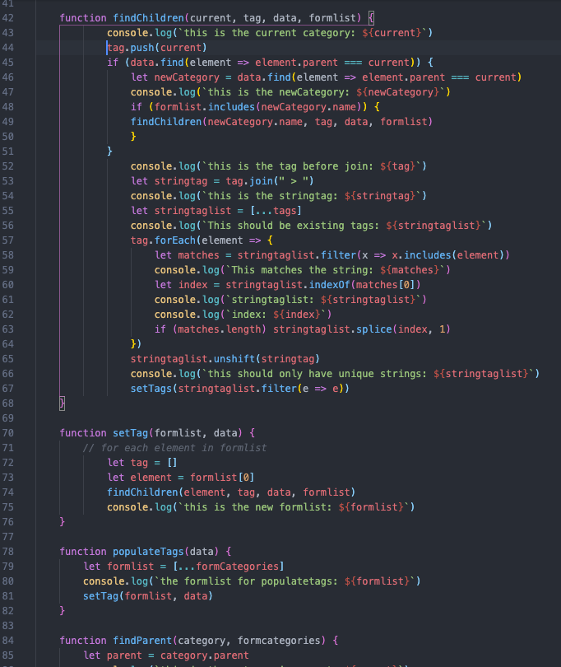
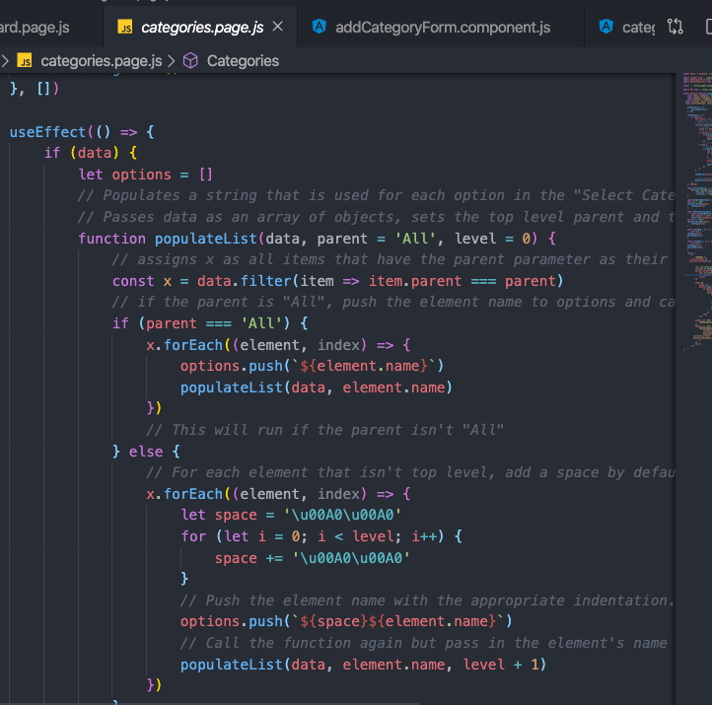
FRONTEND CODE...

Slide 8
<archivise.netlify.com>

Slide 9
LESSONS LEARNED:
ENJOYED:
Learning team Git
Drawing off each others strengths
Learning to successfully TDD
Breakthroughs in logic
Finishing
CHALLENGES:
Learning team Git
Working with a client and evolving ideas
Learning to successfully TDD
Self-imposed high expectations

Slide 10

THANKS!

